Slide 1
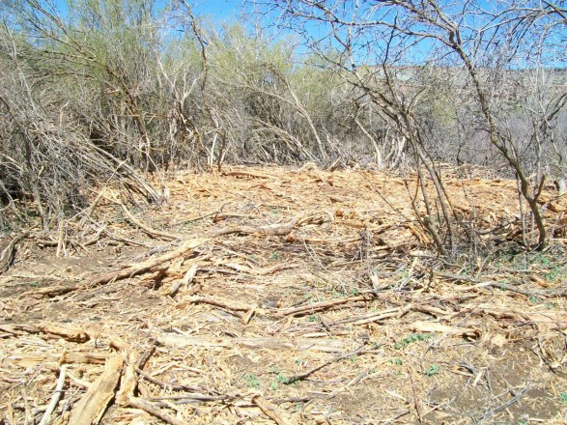
Uncompahgre Field Office
2014 Restoration Implementation -
Cement Bridge to Grand Junction Field Office:
1) 9 ac seeding
2) 9 ac tamarisk
mosaic treatment
3) 9 ac secondary weed treatment
Local Contractor: Backcountry Vegetation Management
In cooperation with adjoining private lands and USFS

Slide 2
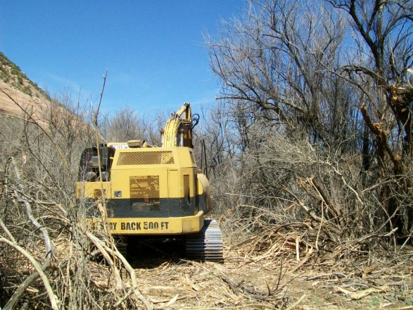
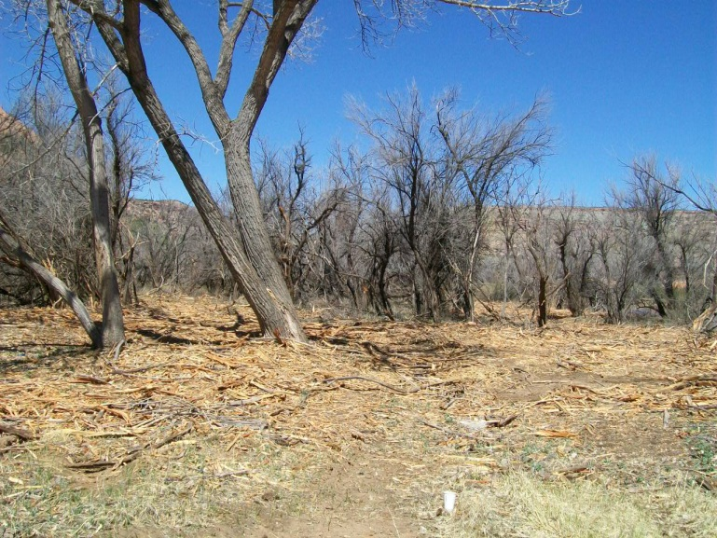
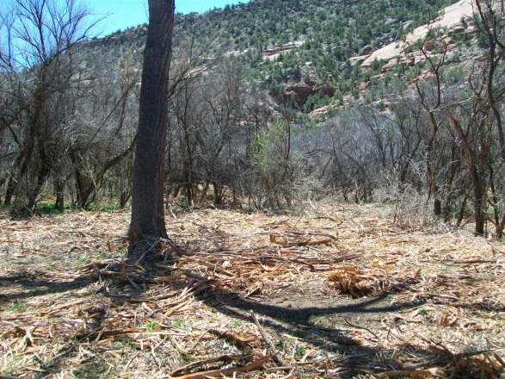
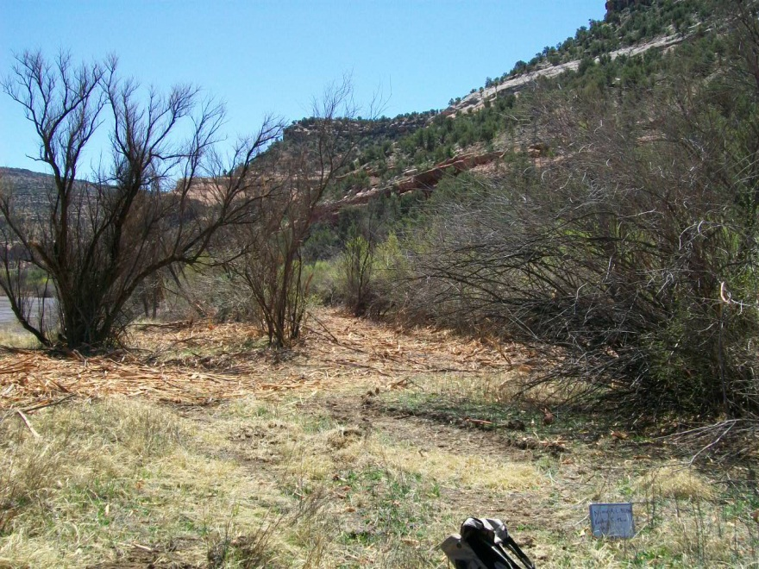

Slide 3
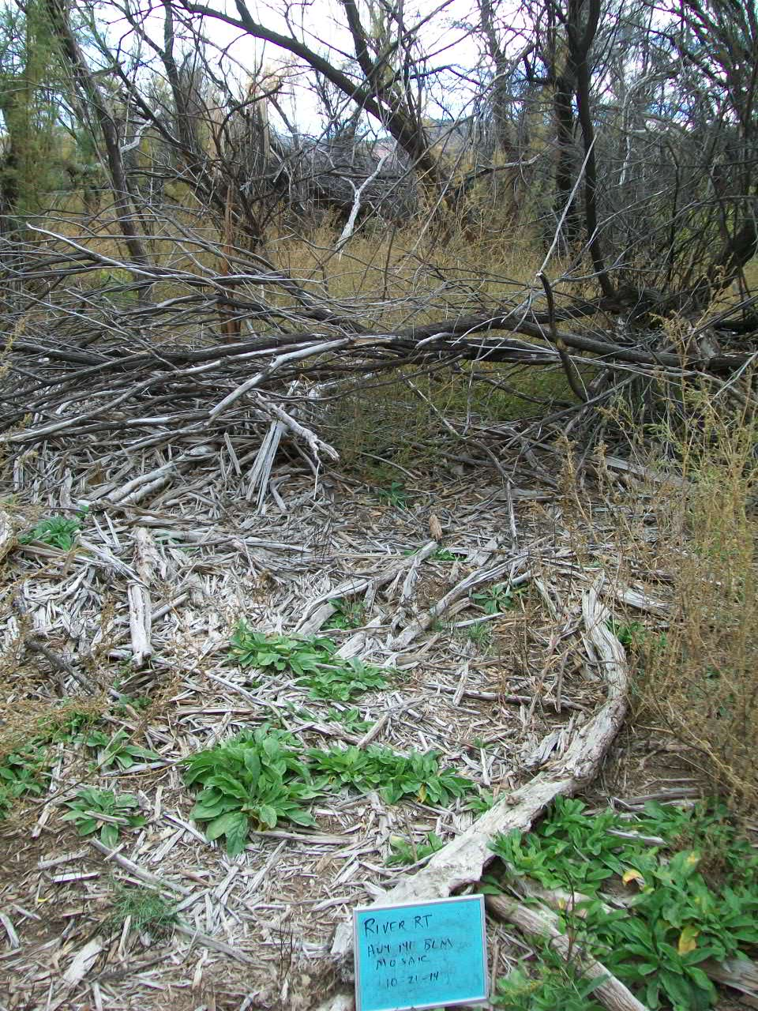
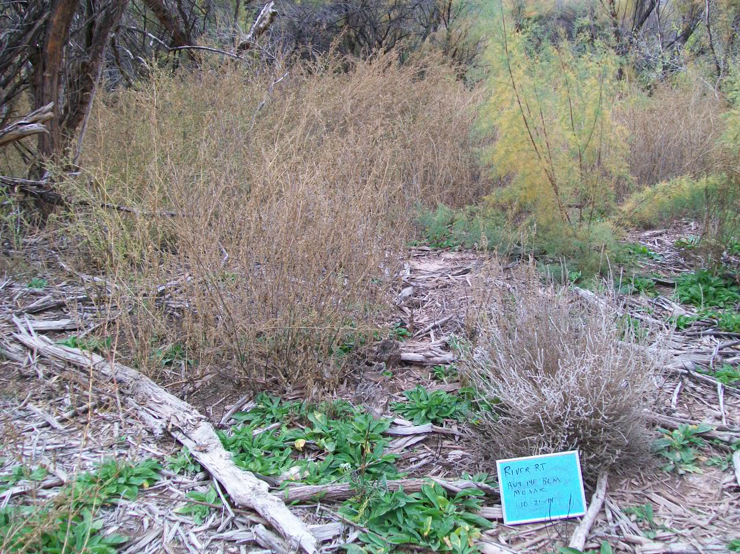

Slide 4
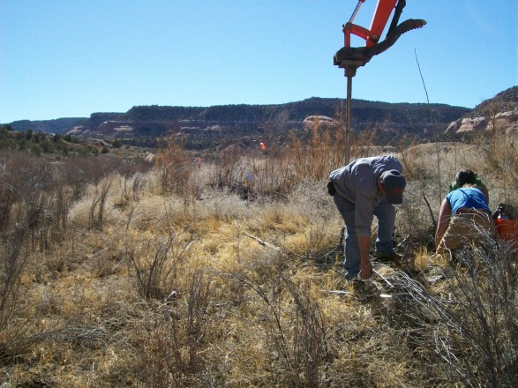
Uncompahgre Field Office
2014 Restoration Implementation –
Pilot Plots
Salinity Testing
Cottonwood planting
Privet planting
Monitoring wells

Slide 5
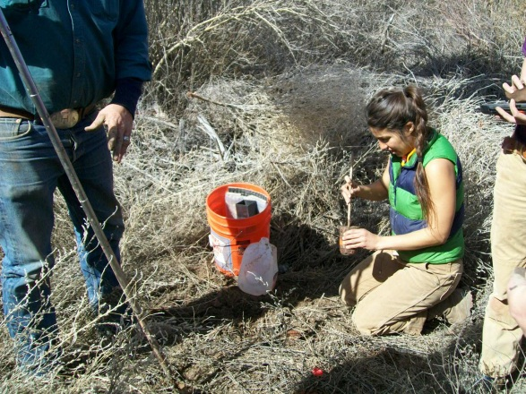
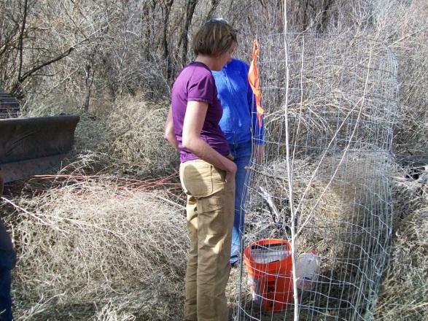
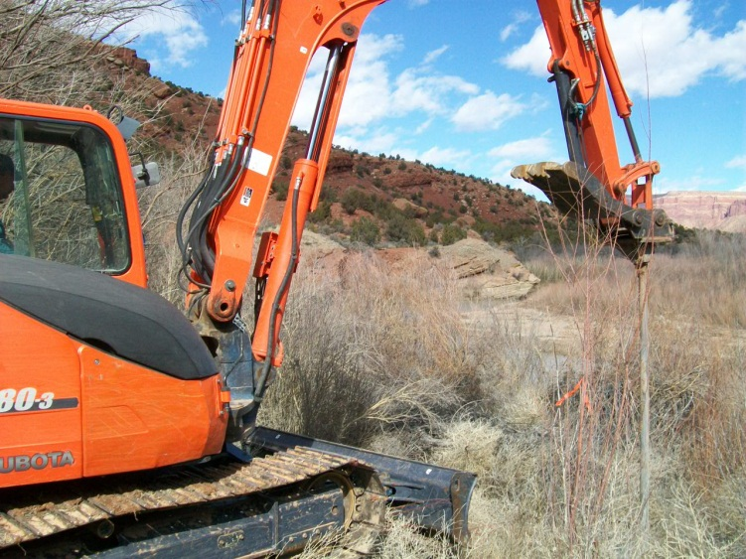

Slide 6
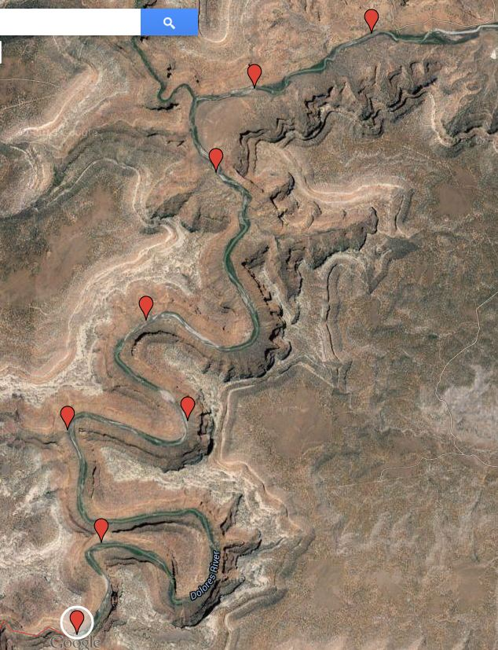
Uncompahgre Field Office
2014 Restoration Implementation -
Dolores River Canyon Wilderness Study Area-targeted tamarisk removal around river camps-to control fire danger: SCC -1 hitch

Slide 7
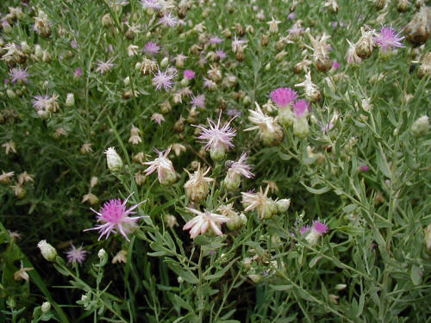
Uncompahgre Field Office
2014 Restoration Implementation -
Dolores River Canyon Wilderness Study Area-
Russian knapweed weed spray contract for 10+ miles of remote river corridor
Local Contractor: Backcountry Vegetation Management

